Slide 1
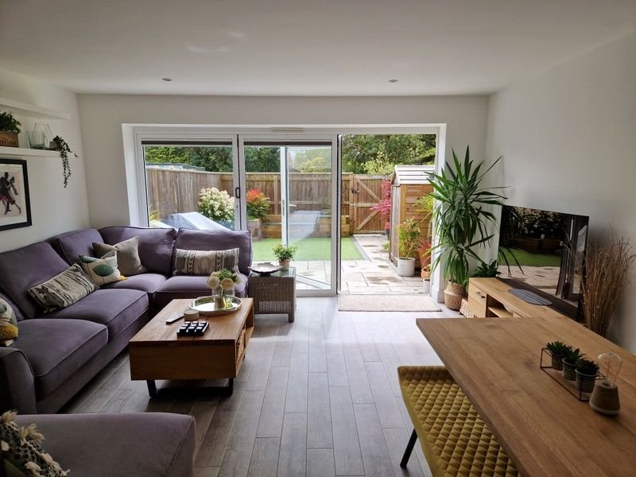
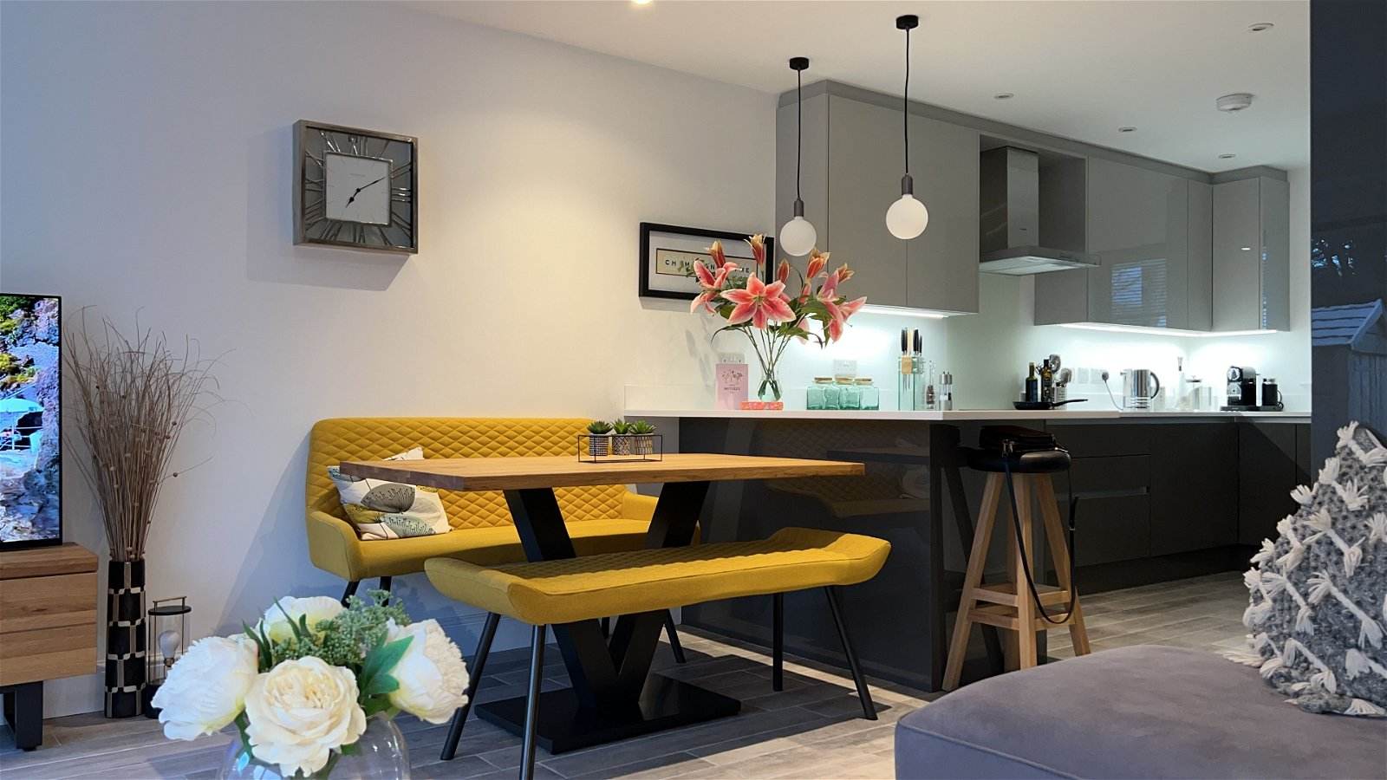
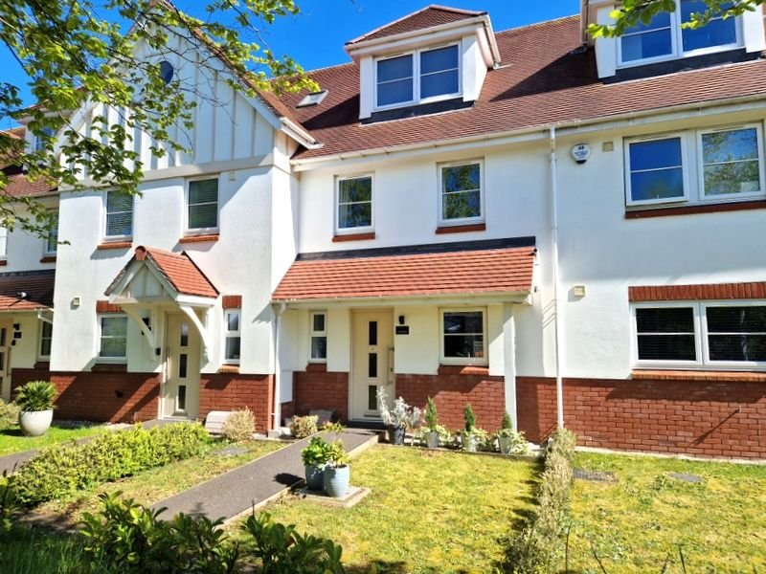
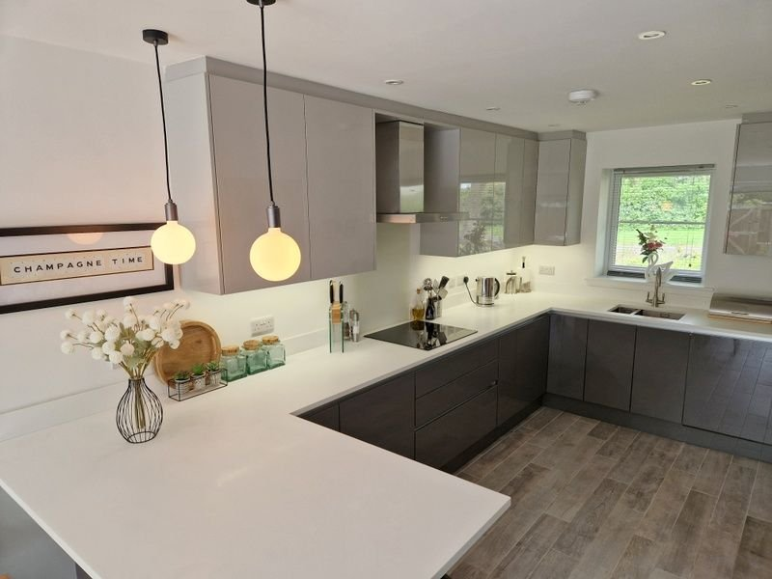
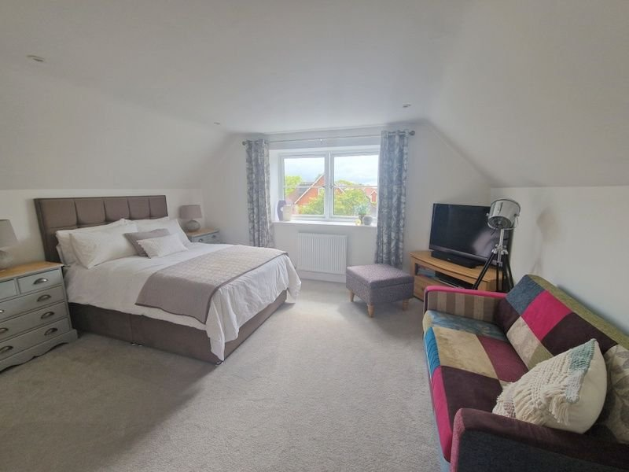
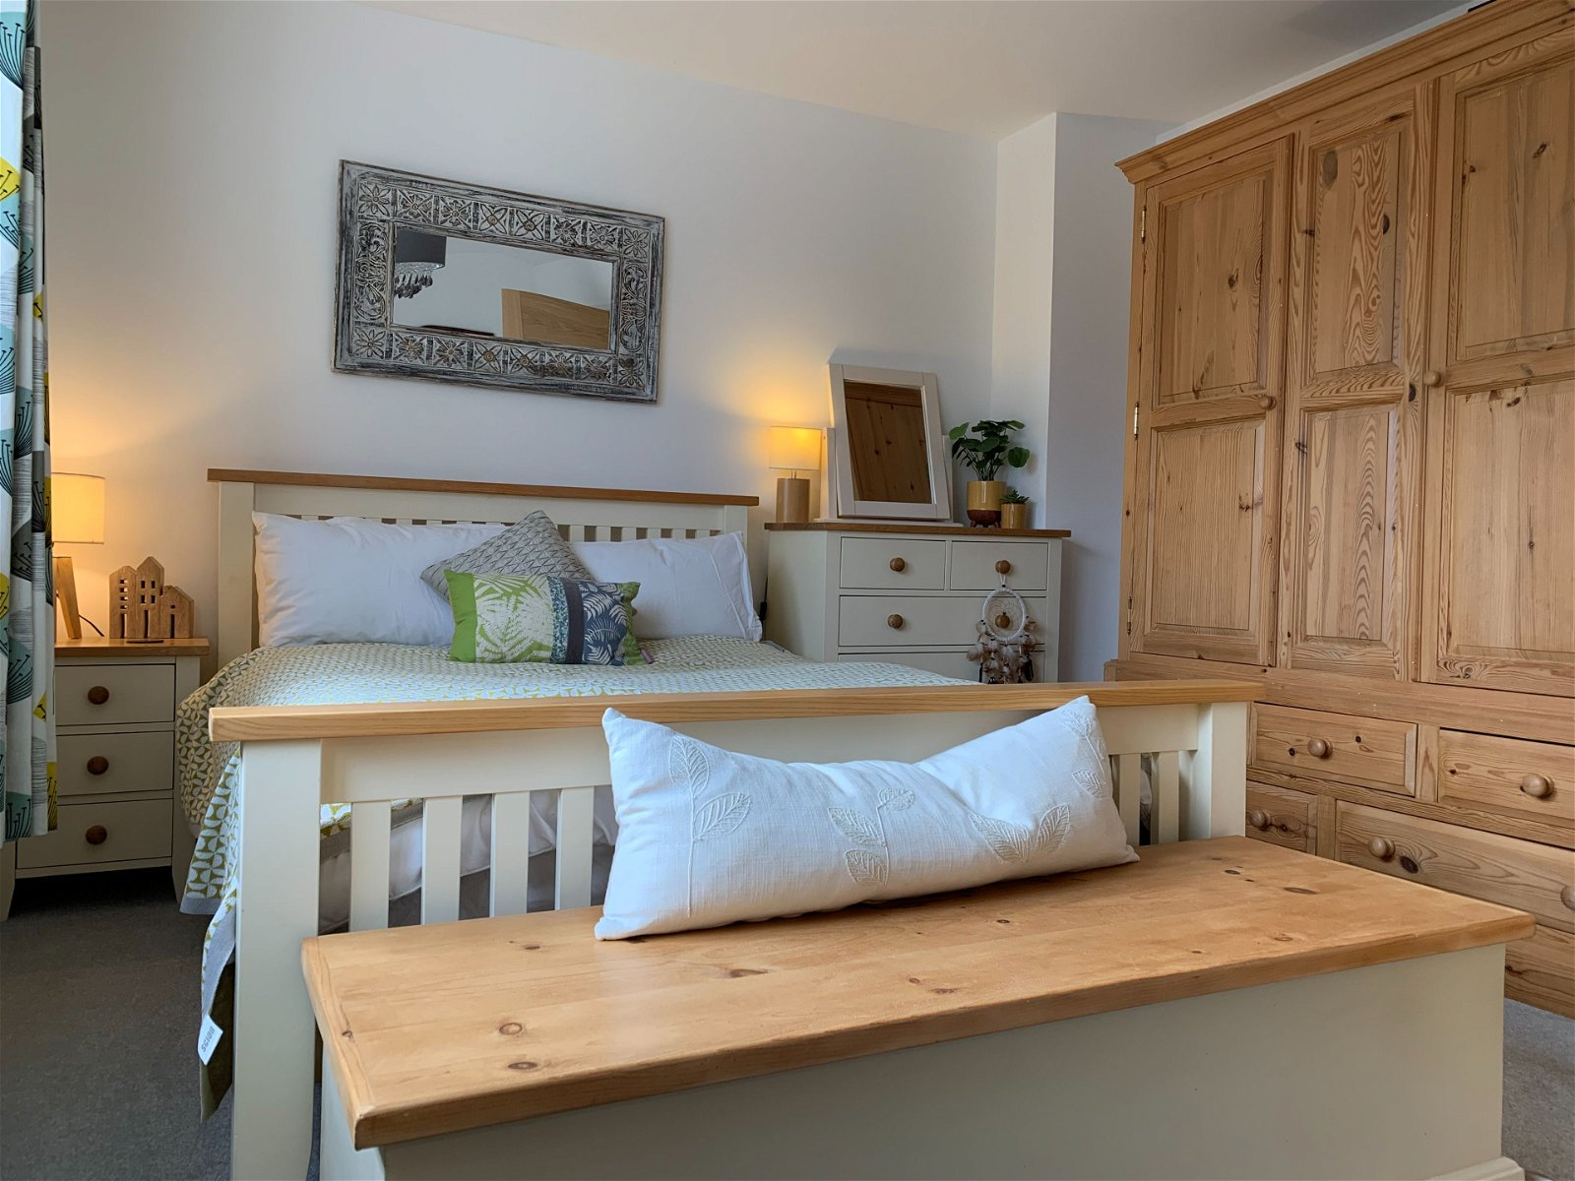
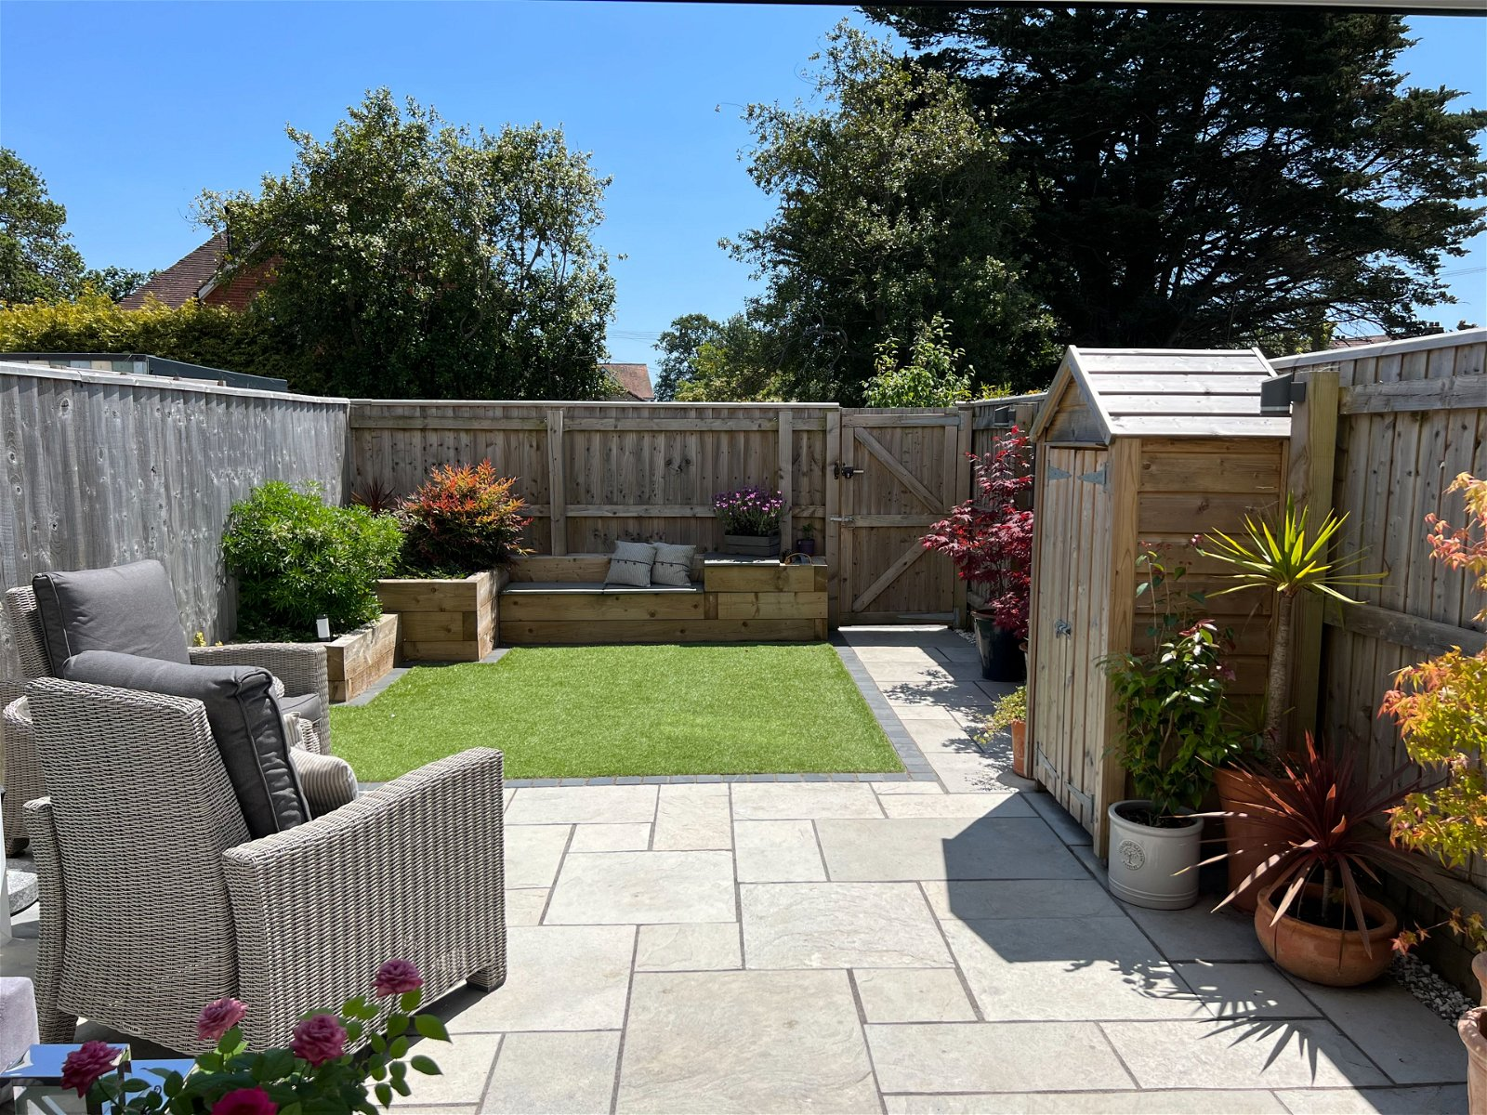
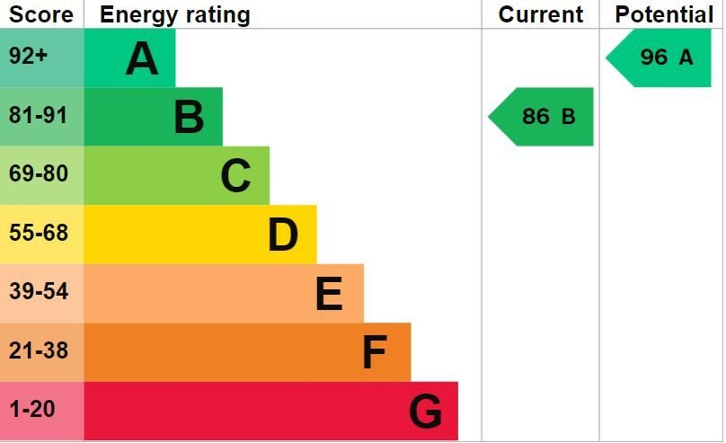
www.pennys.net
Clearwater, The Avenues, 1 Stevenstone Road, Exmouth, EX8 2FY
GUIDE PRICE £469,950
TENURE Freehold
A High Quality Town House Design Modern Home Providing Bright Spacious And Stylish Accommodation With Landscaped Garden And Two Parking Spaces
Select Development Constructed In 2019 * Wonderful Open-Plan Kitchen/Breakfast/Dining And Sitting Room • Three Bedrooms Arranged Over First And Second Floors • Superb Spacious En-Suite Shower Room/WC • Main Family Bathroom Suite • Ground Floor Cloakroom/WC * Gas Central Heating, Double Glazed Windows * Viewing Strongly Recommended
Pennys Estate Agents Limited for themselves and for the vendor of this property whose agents they are give notice that:- (1) These particulars do not constitute any part of an offer or a contract. (2) All statements contained in these particulars are made without responsibility on the part of Pennys Estate Agents Limited. (3) None of the statements contained in these particulars are to be relied upon as a statement or representation of fact. (4) Any intending purchaser must satisfy himself/herself by inspection or otherwise as to the correctness of each of the statements contained in these particulars. (5) The vendor does not make or give and neither do Pennys Estate Agents Limited nor any person in their employment has any authority to make or give any representation or warranty whatever in relation to this property.
PENNYS ESTATE AGENTS
2 Rolle House, Rolle Street, Exmouth, Devon, EX8 2SN
Tel: 01395 264111 EMail: help@pennys.net

Slide 2
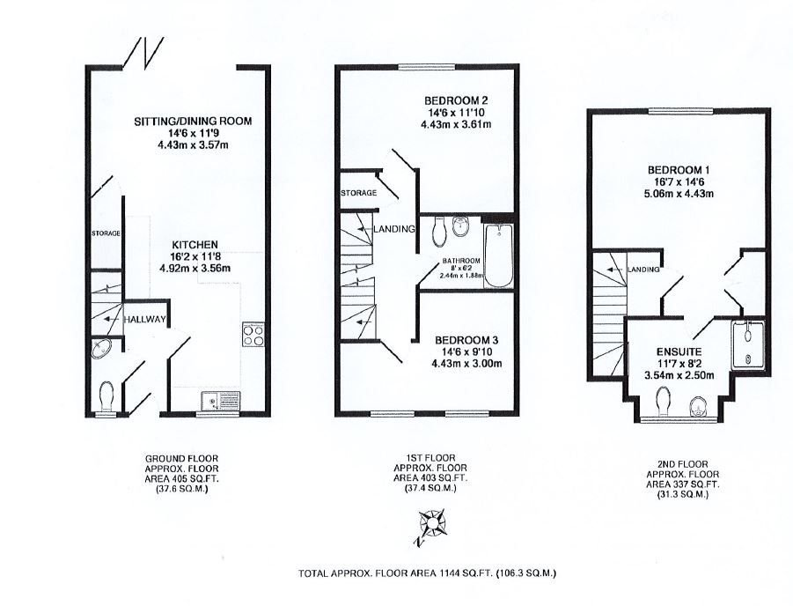
Clearwater, The Avenues, 1 Stevenstone Road, Exmouth, EX8 2FY
Entrance canopy with composite front door giving access to:
ENTRANCE HALL: Recessed LED ceiling spot lighting.
GROUND FLOOR WC: Corner wash hand basin with chrome mixer tap, WC with concealed cistern and push button flush, electric consumer unit, attractive part-tiled walls, colour co-ordinated tiled flooring, double glazed window with patterned glass.
OPEN-PLAN KITCHEN/BREAKFAST ROOM AND SITTING/DINING ROOM: A wonderful open-plan living space with under floor heating, comprising…
KITCHEN AREA: 4.93m x 3.56m (16'2" x 11'8") Fitted with a range of working surfaces extended to provide a breakfast bar area with wide range of cupboards and drawer units, integrated washer/dryer machine and dishwasher beneath worktops, inset one and half bowl sink unit with chrome mixer tap. Worktops with matching splashbacks, range of wall-mounted cupboards with concealed lighting beneath. Integrated fridge and freezer, built-in double oven, induction hob with cupboards above and below. Upright larder cupboard. Recessed ceiling LED spot lighting and down lighting over breakfast bar area. Wall-mounted cupboard – one houses the boiler for hot water and central heating.
SITTING/DINING ROOM: 4.42m x 3.58m (14'6" x 11'9") A bright living space with bi-folding doors opening onto the rear garden. TV point, recessed ceiling LED spot lighting and access to understair storage cupboard.
FIRST FLOOR LANDING: Radiator, ceiling spot lighting, staircase rising to SECOND FLOOR LANDING. Good size storage cupboard.
BEDROOM 2: 4.42m x 3.61m (14'6" x 11'10") max. overall measurement. Double glazed window over rear aspect. Radiator. TV point.
BEDROOM 3: 4.42m x 3.00m (14'6" x 9'10") max. overall measurement. A bright room with two double glazed windows to front aspect. Radiator. TV point.
BATHROOM/WC: 2.44m x 1.88m (8'0" x 6'2") Stylishly fitted comprising; bath with shower unit with rainfall head hose and detachable shower head hose. Shower splash screen, wash hand basin with chrome mixer tap and storage cabinet beneath. WC with concealed cistern and push button flush. Large fitted mirror, chrome heated radiator, attractive tiling to splash prone areas with colour co-ordinated tiled flooring, shaver socket, large fitted mirror, ceiling extractor fan, recessed ceiling LED spot lighting.
SECOND FLOOR LANDING: Access to roof space.
MAIN BEDROOM 1: 5.05m x 4.42m (16'7" x 14'6") max. overall measurement. Superb main bedroom with feature part sloping ceiling and recessed ceiling LED spot lighting. Radiator, TV point, built-in wardrobes, double glazed window to rear elevation.
EN-SUITE SHOWER ROOM/WC: 3.53m x 2.49m (11'7" x 8'2") A most spacious en-suite room with ease of access walk-in shower cubicle with shower splash screen, rainfall shower head with hose and detachable shower head hose. Wall-mounted wash hand basin with chrome mixer tap, WC with concealed cistern and push button flush. Chrome heated towel rail, attractive tiling to splash prone areas with colour co-ordinated tiled flooring, shaver socket, ceiling extractor fan, recessed ceiling LED spot lighting. Double glazed window to front elevation.
OUTSIDE: Forming part of a select row of town houses, the property is approached by a pedestrian gate and pedestrian pathway. There is a small area of garden directly to the front of the property. To the rear the garden has been well planned and landscaped with ease of maintenance in mind comprising of a patio sun terrace ideal for entertaining. Artificial lawn area and raised flower and shrub beds, and seating area. Outside electric point. Rear pedestrian gate gives access to TWO PARKING SPACES (personal/private electric car charging station conveniently located next to the two allocated parking spaces - power to the charging point can be switched off from inside the property, if not in use). Vehicular access via Stevenstone Road.
FLOOR PLAN:

